Slide 1

Object-Oriented Programming Discussion, Lecture, & Lab Eric Pogue
Agenda for Wednesday, September 25th from 2 to 2:50pm CST:
Friendly Conversation Topic – Self-Improvement and Working with Teams… or Uline
Assignment from Last Class
Discuss Sprint 2 Assignments
Assignment for Next Class
Lab
Discussion & Questions welcome at any time… please be present with no phones or email during our time together

Slide 2
Self-Improvement and Working with Teams … Or Uline
Notes:
https://www.uline.jobs/JobSearchResults?culture=en&department=information%20technology&sort=Department-asc
Starting at 3pm in 106A

Slide 3
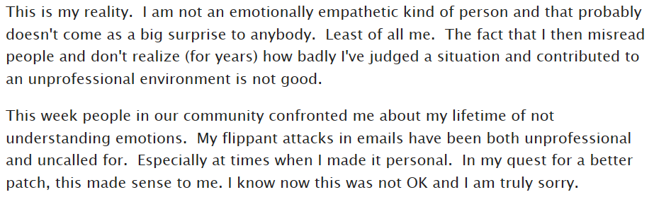
Who is the Author

Slide 4
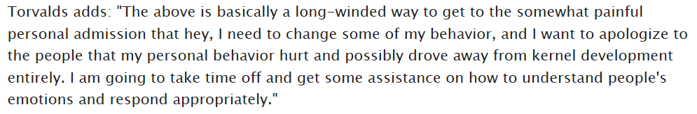
Answer

Slide 5
Suggested Reading: Dale Carnegie

Slide 6
Notes:
Optimism & Good-natured Humor

Slide 7
Discuss Sprint 2 Assignments

Slide 8
Assignment
Complete Activities List items through item 5 and be prepared to discuss them at the start of our next class.

Slide 9
Lab
As A Scrum Team:
FaceDraw, FaceDraw, FaceDraw
Team report out by new Scrum Master at 2:48
Team Report Out Guidelines
Scrum Master will stand up, give your name, your team name, and briefly answer the following questions:
What did you accomplish since the last meeting? And what will you be working on until the next meeting?
Is the team committed to completing assignments? All/Most/Some
What is getting in your way or keeping you from completing the assignments?

Slide 10
End of Session

